Slide 1
Region Västerbotten

Slide 2
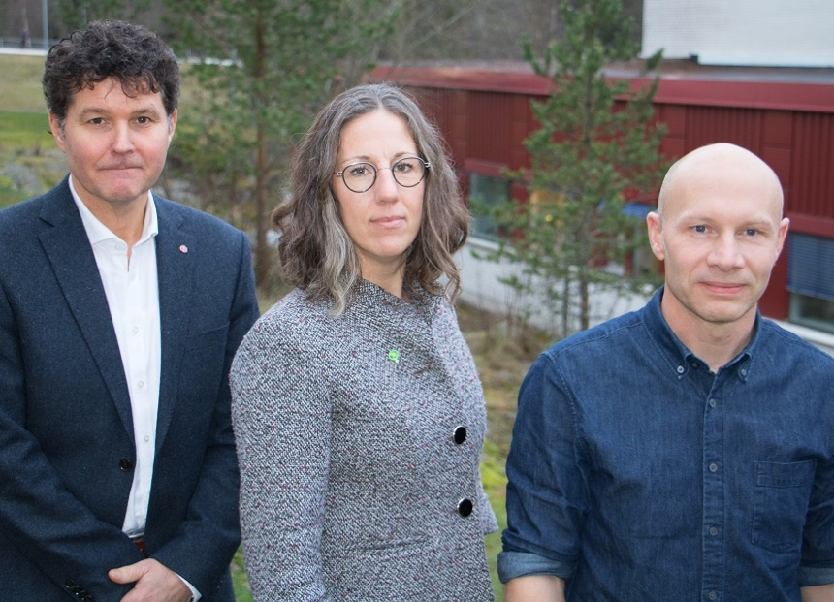
We gather strength and expertise
The region has two important assignments which need and are prerequisite of each other – healthcare and regional development. Together we are stronger and have better conditions for a strong, long-term and sustainable development.
We can also create the best conditions for collaboration with the municipalities. Furthermore, an organisation with directly elected politicians will strengthen the influence of the people of Västerbotten on the county's development.
Peter Olofsson (S), Emma Lindqvist (MP), Jonas Carlberg (V)

Slide 3
Region Västerbotten's vision
From the mountains to the coast, together we create an attractive region with good living conditions for everyone.
The whole region
Collaboration
Diversity
Social cohesion
Unifying force
Together
Communications
Dialogue
Collaborate
Inclusion
Network
Community
The county’s municipalities
Organisations
and business
Labor market
Sustainable development
Integration
Welfare
Accessibility
Culture
Associations
Growth
Experiences
Development opportunities
Education
Public health
Environment
Habitat
Healthcare
Work environment
Activity
Equal and gender equal

Slide 4
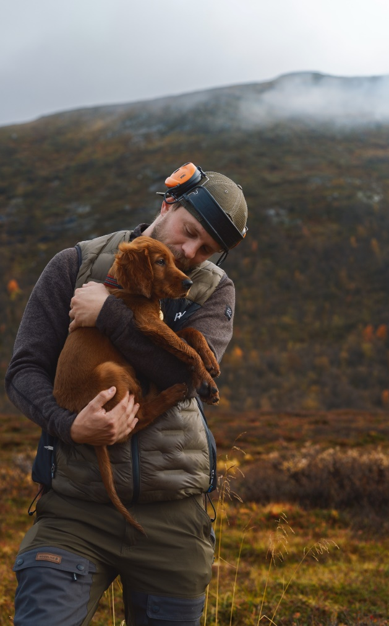
Region Västerbotten's goals
Safe conditions for growing up
Good living conditions
An attractive and sustainable Västerbotten
Accessible care with good quality and continuity
Good workplaces and attractive employers
A sustainable region for environment and climate
Strengthened research, education and innovation.

Slide 5
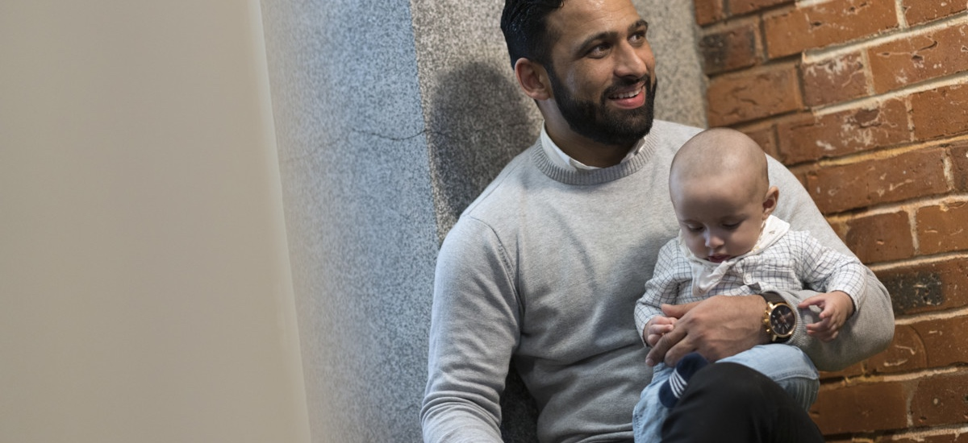
Health, care and development.
Sustainable together.

Slide 6
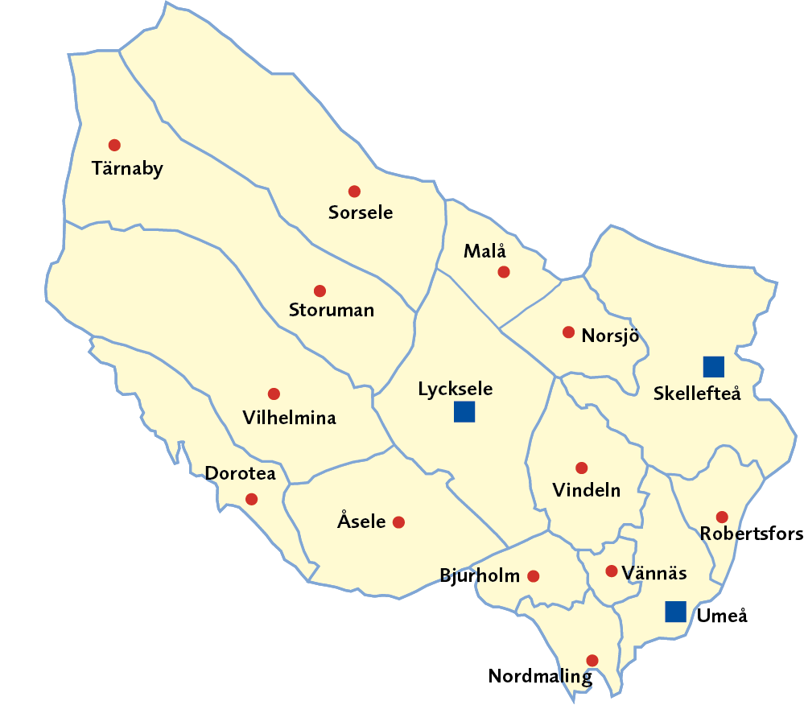
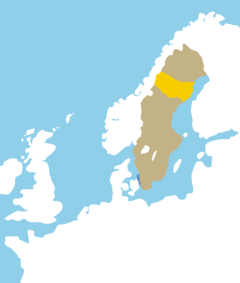
Västerbotten County
Land area: 54 665 km², one-eight of Sweden and the second largest county by area
Population 2024:
281,404 people
2.65 % of Swedes live in Västerbotten
Source: Statistics Sweden

Slide 7
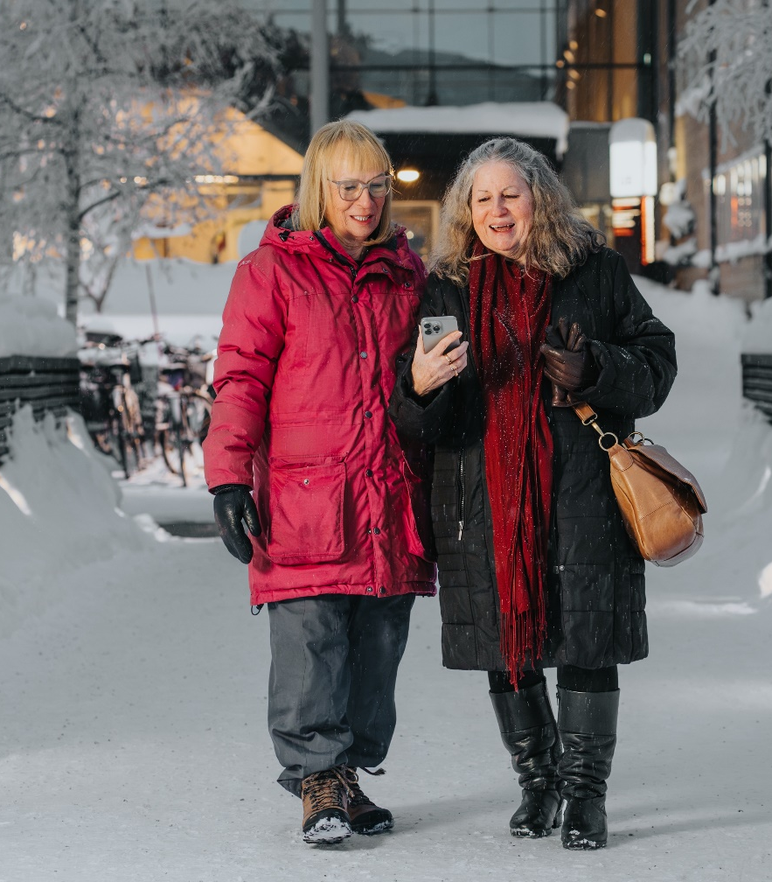
The region's main mission
Healthcare and dental care
Public health and social welfare
Public transport
Regional development and culture
Research, innovation and education
Engagement in the county's interests nationally and internationally.

Slide 8
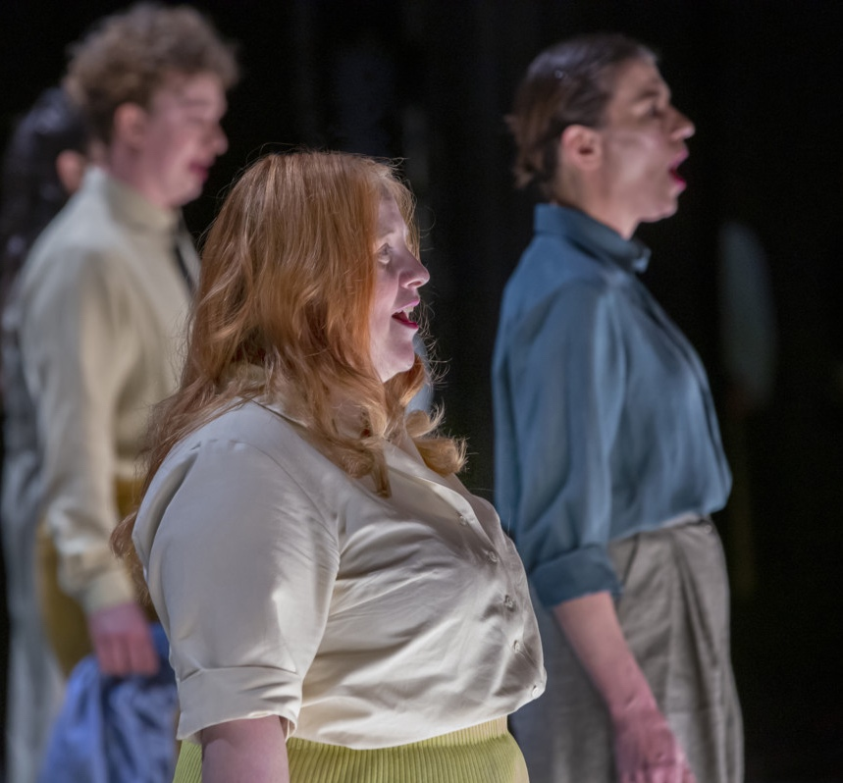
Regional development
Business and innovation
Infrastructure
Culture
Tourism
Education and skills provision
IT and digitalisation
Environment, energy and more.

Slide 9
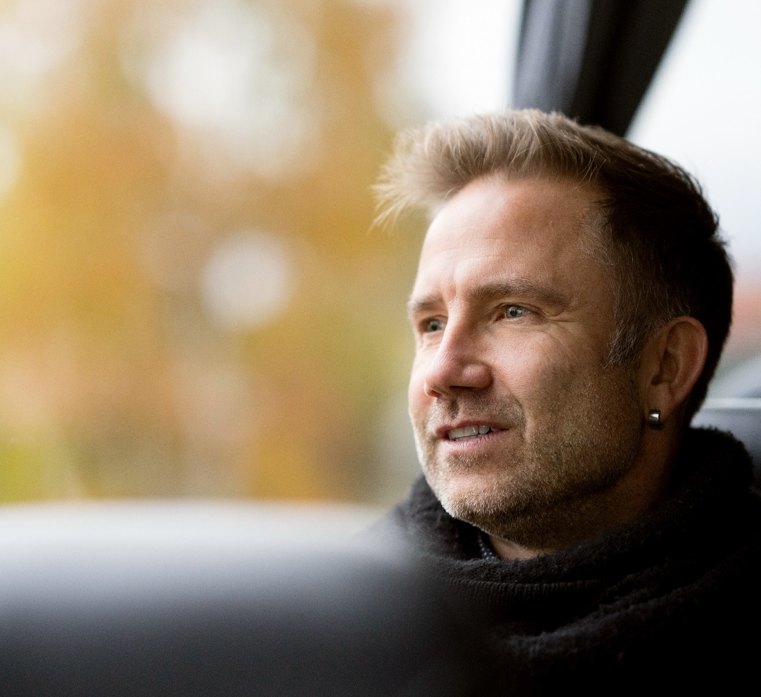
Regional growth
We prepare and decide on the use of state funds for regional growth.
In this work, we ensure that appropriations for regional growth are distributed equally, to contribute to social sustainability.

Slide 10
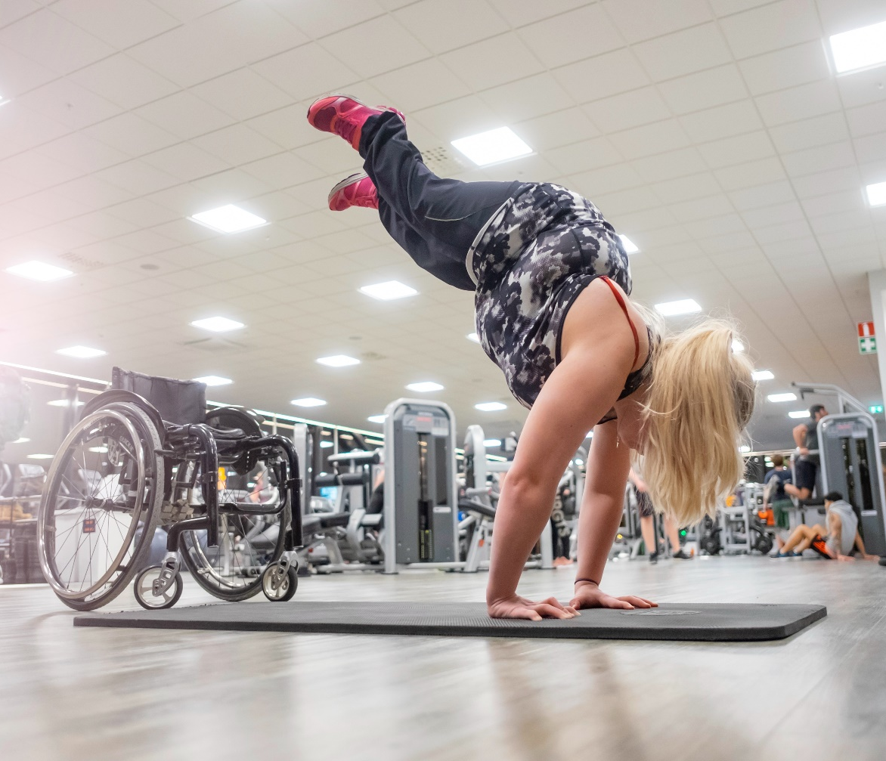
Public health work
Västerbotten Intervention Programme
The Salut Programme
Equal and gender equal health
Epidemiological surveillance
Mental health.

Slide 11
Healthcare

Slide 12

1177 – Advice on health and healthcare online
The website 1177.se provides information and advice about health, illness and care.
Log in to read your medical records and manage healthcare matters.
1177 helpline for medical advice at any time.

Slide 13
Health and medical care
University, regional and county hospital
District hospital
Healthcare centre
Cottage hospital (healthcare centre with emergency beds)
Psychiatric care
Behavioral medicine treatment unit
Rehabilitation unit

Slide 14
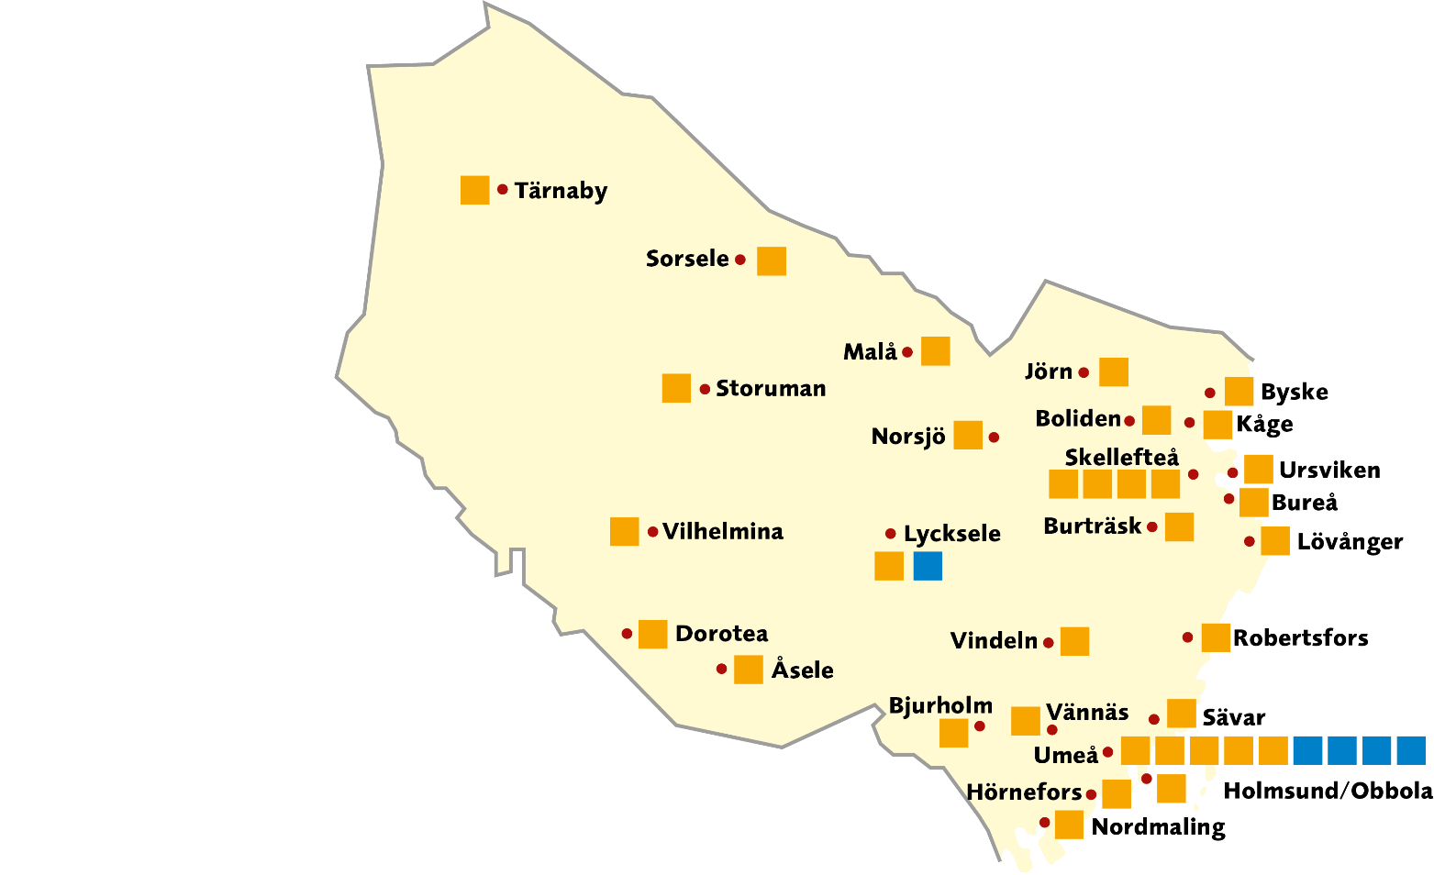

Healthcare centres
Healthcare centre
Region Västerbotten
Private healthcare centre

Slide 15
Hospital care in Sweden
The Northern healthcare region covers half of Sweden's area and has circa 904,370 inhabitants.
University and Regional Hospital
County Hospitals
Northern Healthcare Region
Healthcare Region central Sweden
Healthcare Region Stockholm-Gotland
Western Healthcare Region
South-Eastern Healthcare Region
Southern Healthcare Region

Slide 16
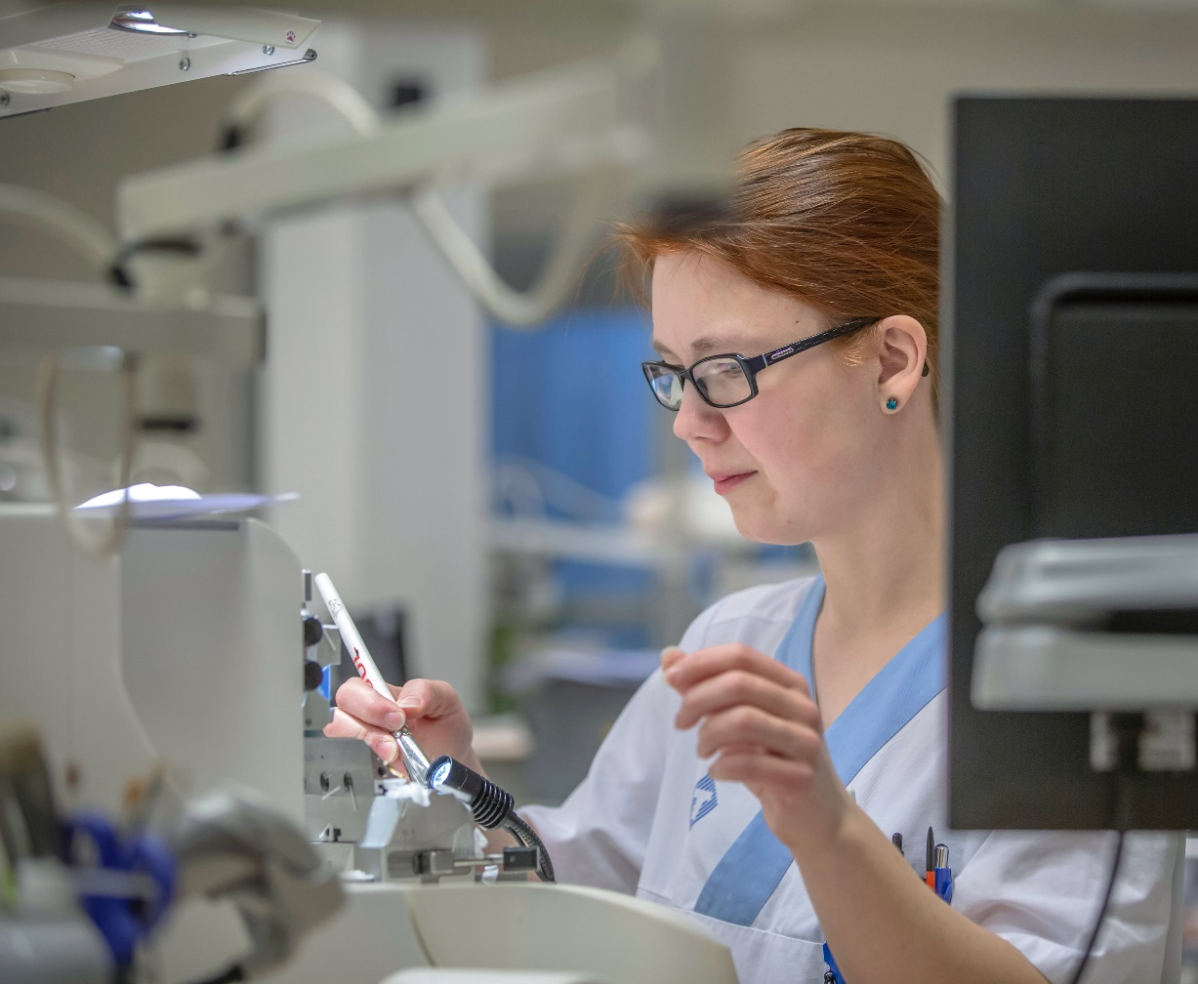
University Hospital of Umeå
Tertiary care
Research
Teaching

Slide 17
National specialised medical care
Start date in parentheses.
The licences are valid until further notice.
Anal cancer (1 January 2027)
Dysmelia (1 September 2025)
Brachial Plexus injuries
(1 January 2016)
Primary sclerosing cholangitis
(15 December 2021)
Spinal cord injuries (1 April 2023)
Systemic amyloidosis (1 July 2024)
Rare lung diseases in children
(1 January 2023)
Winged scapula (1 June 2026)

Slide 18
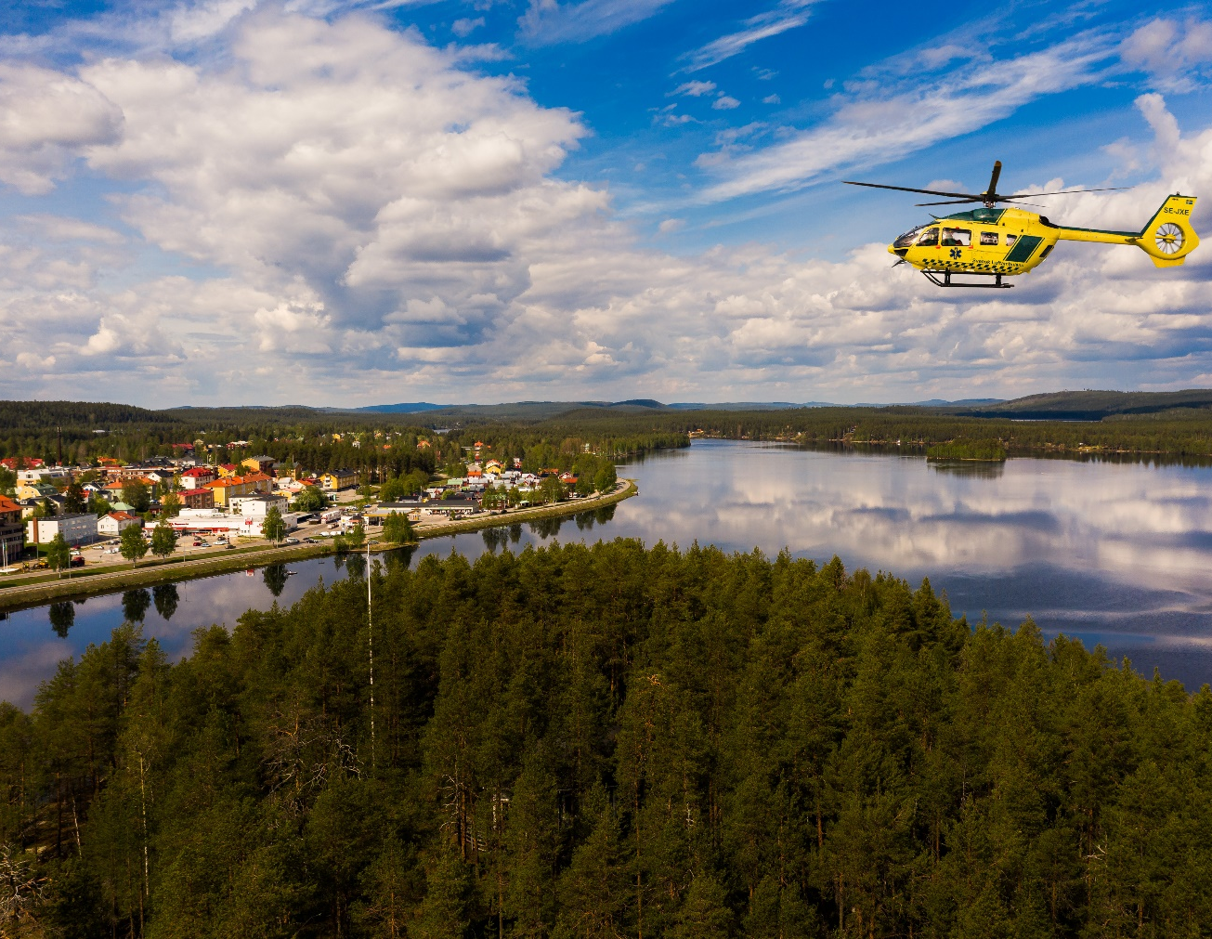
Lycksele hospital
Emergency care in surgery, medicine and orthopaedics
Diagnostic centre
Orthopaedic surgeries

Slide 19
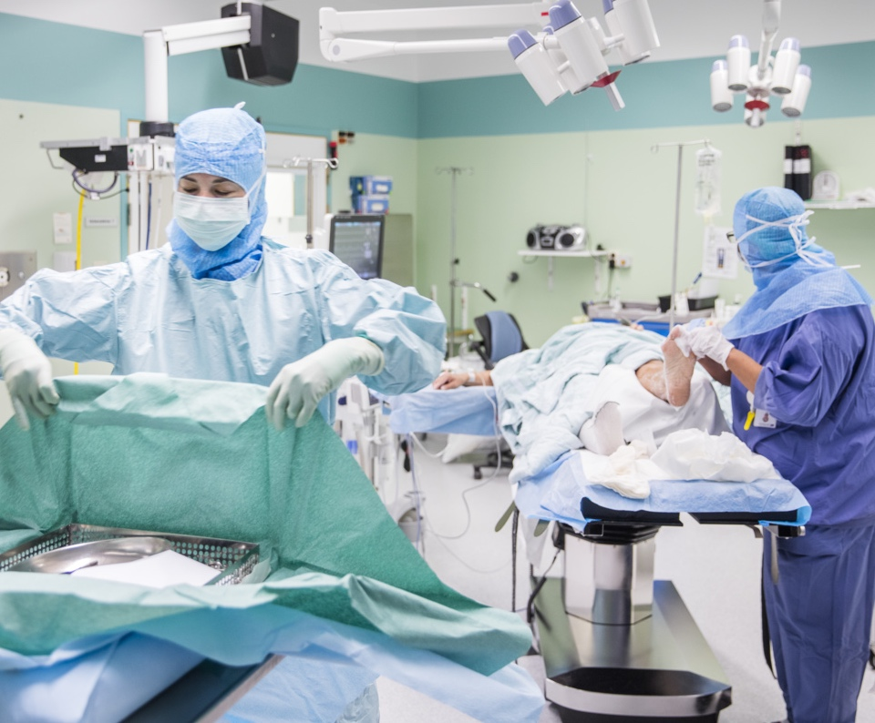
Skellefteå hospital
Emergency care
Specialised care
Research

Slide 20
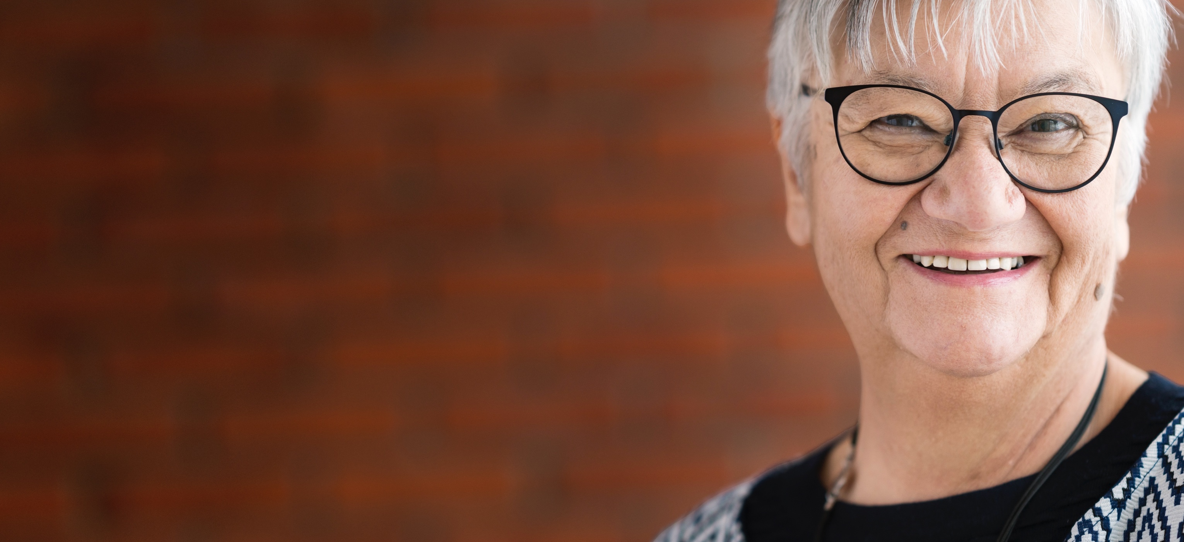
One year of health and medical care
40,000 episodes of care
35, 000 surgical procedures
350,000 specialist outpatient visits
213,000 primary care doctor visits
416,000 specialised medical treatments
425,000 primary care medical treatments
215,000 dental care visits
146,000 phone calls to 1177 helpline

Slide 21
Public dental care
Dental clinic
Orthodontic clinic
Academic dentistry in Norrland

Slide 22
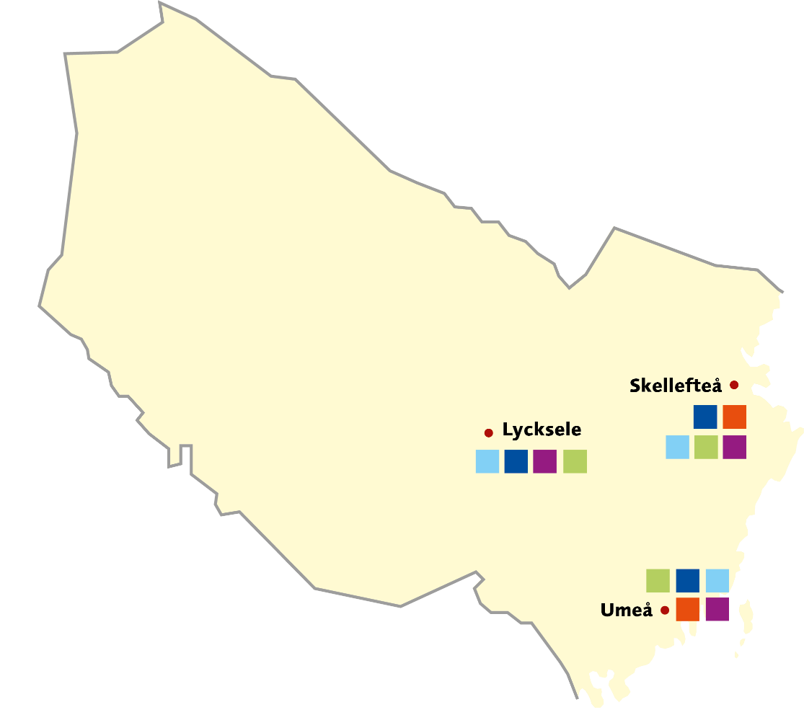
Activities for people with physical impairments
Child and adolescent habilitation
Adult habilitation, advice and support
Vision and hearing rehabilitation
Accessibility aid
Interpreting centre
Skellefteå
Lycksele
Umeå

Slide 23
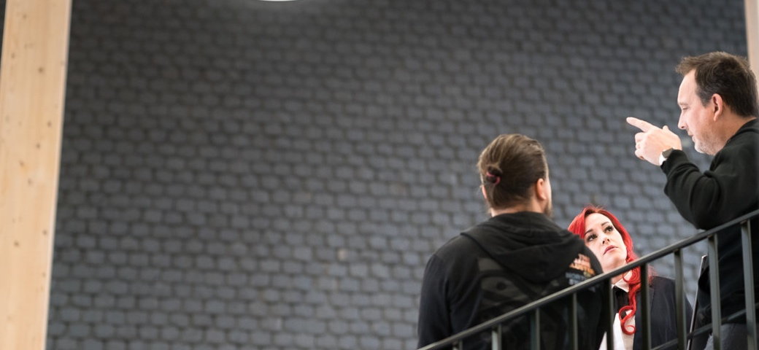
11,000 Employees
University Hospital of Umeå is northern Sweden's largest workplace with 6,500 employees.

Slide 24
This is how the region is governed

Slide 25
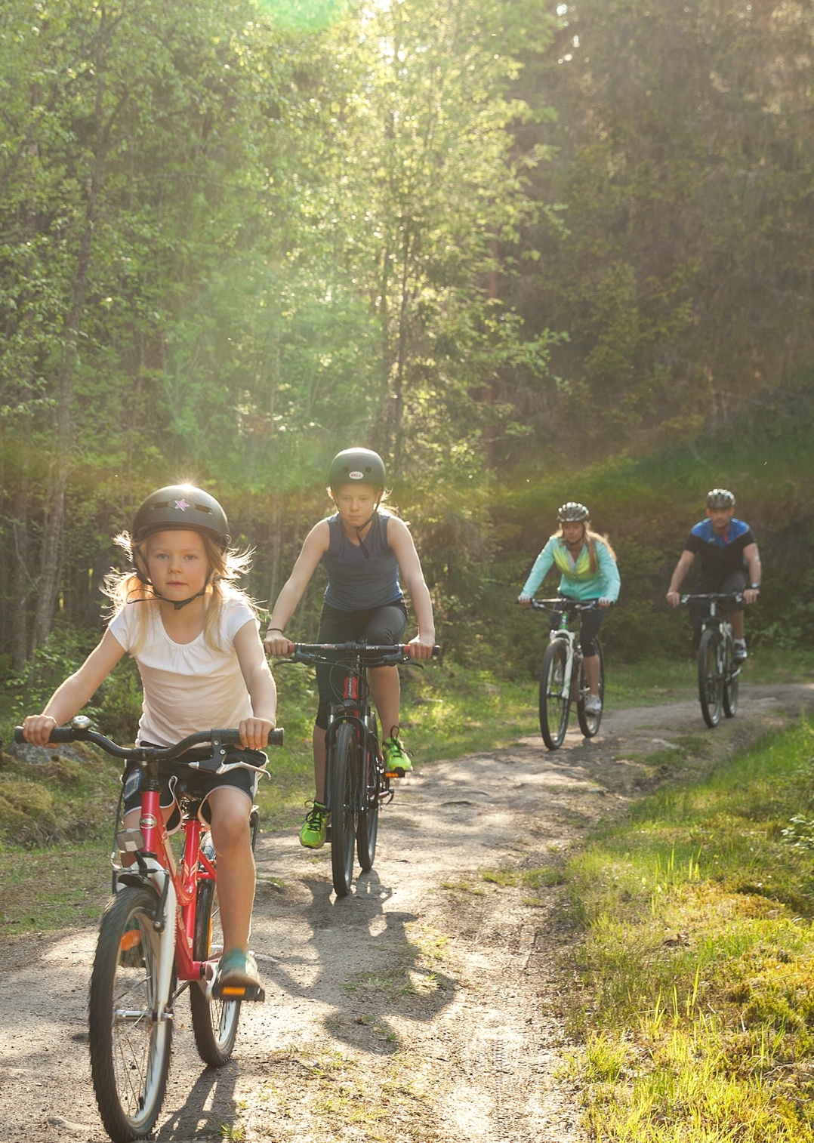
This is how the region is governed
Clear division of responsibilities between politicians and civil servants.
Politicians set goals for the organisation.
The civil servants implement the decisions.
Follow-up and evaluation.
Ongoing reporting on organisation and finances.

Slide 26
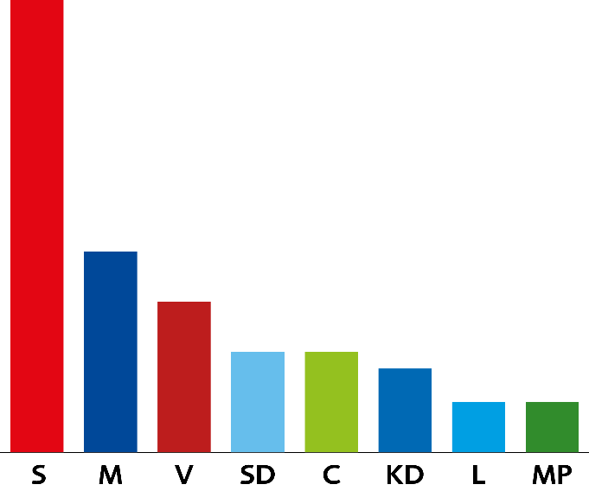
Allocation of seats in the Regional Council
The Social Democratic Party .. 27 (37.12 %)
The Moderate Party .……........ 12 (16.89 %)
The Left Party……..……….....….... 9 (11.87 %)
The Sweden Democrats …......... 6 (8.89 %)
The Centre Party ……………......... 6 (8.63 %)
The Christian Democrats .…....... 5 (7.06 %)
The Liberal Party ……….…........…. 3 (4.38 %)
The Green Party ……….….........…. 3 (3.79 %)
Total 71 seats
Share of votes in per cent and number of seats in the Regional Council for the period 1 November 2022–31 October 2026.

Slide 27
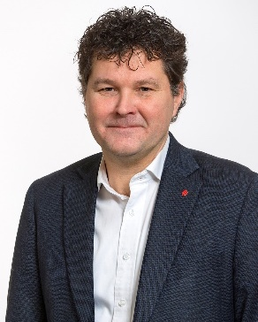
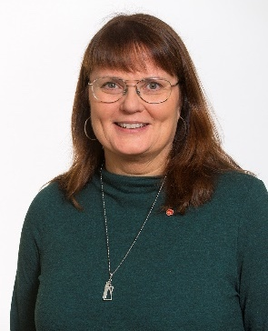
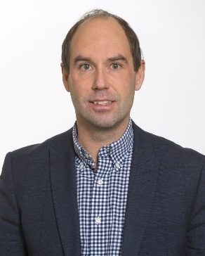
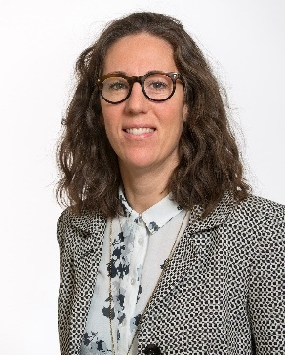
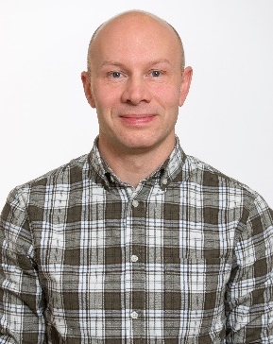
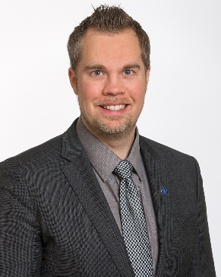
Regional Council
Peter
Olofsson (S)
Obbola, Regional Councillor,
Chair of the Regional Executive Board
Anna-Lena
Danielsson (S)
Lycksele, Regional Councillor,
Chair of the
Health and Medical Committee
Rickard
Carstedt (S)
Burträsk, Regional Councillor,
Chair of the Regional Development Committee
Emma
Lindqvist (MP)
Umeå, Regional Councillor,
responsible for environment, climate
and sustainability
Jonas
Carlberg (V)
Umeå, Regional Councillor, 2nd Vice Chair of the Regional Executive Board, responsible for equality and gender equality
Nicklas
Sandström (M)
Umeå, Regional Councillor, 1st Vice Chair of the Regional Executive Board

Slide 28
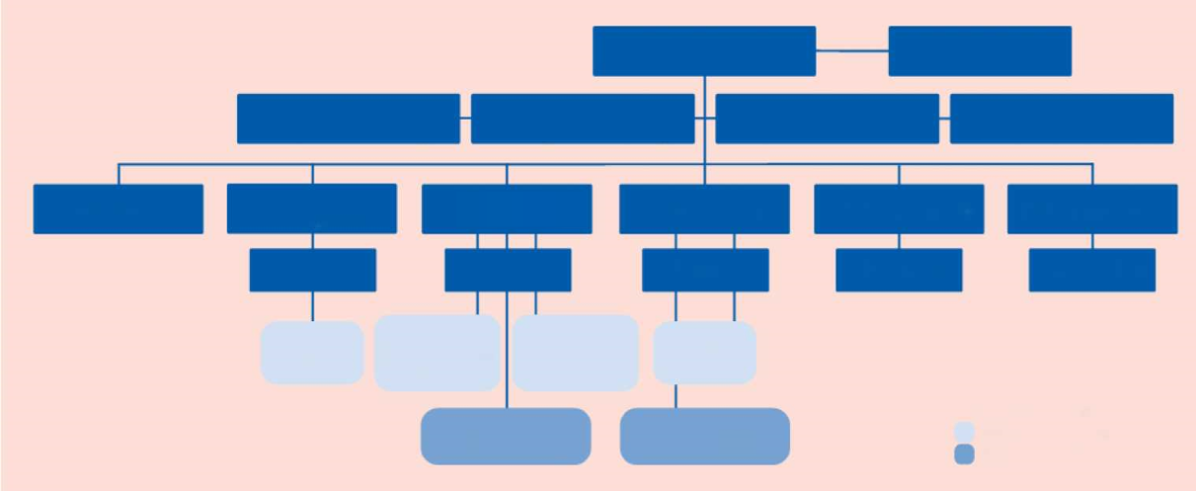
Political organisation 2023–2026
Regional Council
Audit
Preparatory Committee
for Skills Supply
Preparatory Committee for Collaboration and Regional Development
Democracy Preparatory
Committee
Nomination
Committee
Patient Advisory
Committee
Regional Development Committee
Health and Medical Committee
Regional Executive
Board
Folk High School
Committee
Crisis Management
Committee
Working
Committee
Working
Committee
Working
Committee
Working
Committee
Working
Committee
Preparatory Committee for Culture
Preparatory Committee for Disability and Collaboration
Preparatory Committee for Primary care and dental care
Preparatory Committee for Public Health
The general council's decision
does not include
Collaboration Forum for Health and social care
Regional Executive
Meeting
Board preparations
Collaborative bodies

Slide 29
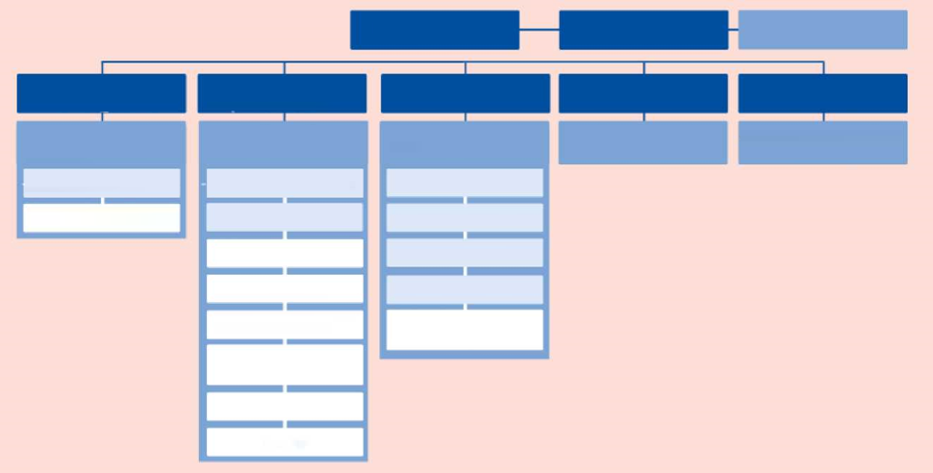
Civil service organisation
Regional Council
Audit
Audit Office
Regional Development Committee
Health and Medical Committee
Regional Executive
Board
Patient Advisory
Committee
Folk High School
Committee
Regional development Management
Health and Medical Management
Regional
Management
Patient Advisory Management
Folk High School Committee Management
Regional Development
Office
Health and Medical
Office
Finance Office
Regional Development
RDI Office
HR Office
County Health Care
Area 1
Communications Office
County Health Care
Area 2
Management Office
Primary and Secondary
Health Care Skellefteå
Digitalisation
and Service
Primary and Secondary Health Care Southern Lapland
Primary and Secondary
Health Care Umeå
Dental Care

Slide 30
